Slide 1


Real-Time SIEM-Based Cybersecurity Framework for Threat Detection and Prevention in IoMT Environments
25-26J-70
Cyber Security
2026 - 01 - 05
Notes:
1

Slide 2

Group Members - Component
UKASHA MMM – IT22904232
Monitoring System
FIRAZ M MN - IT22034304
AI Threat Intelligence Engine
BASHEER MS - IT22031570
Adaptive Incident Correlation Engine
– AICE
AGMK GUNASEKARA - IT22587138
Automated Response System
Supervisor : Mr. Kanishka Yapa
Co – Supervisor : Deemantha Siriwardhana
25-26J-70
Cyber Security
2026 - 01 - 05

Slide 3
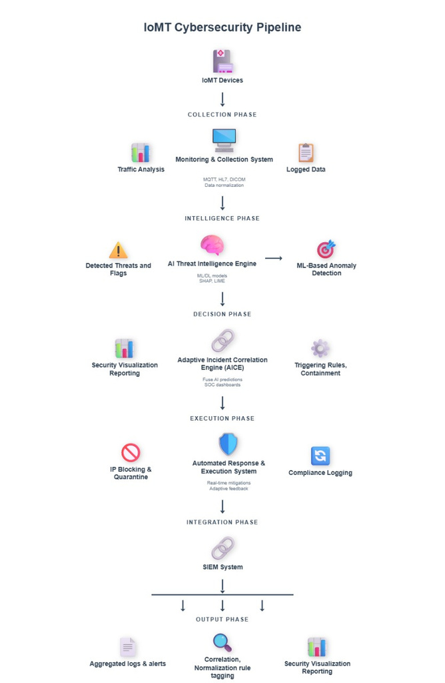
System Diagram
25-26J-70
Cyber Security
2026 - 01 - 05

Slide 4
PROBLEM
IMPACT
The rapid adoption of Internet of Medical Things (IoMT) devices in Sri Lankan hospitals has expanded the healthcare attack surface, while many devices operate with limited security, outdated firmware, and diverse communication protocols.
Existing cybersecurity and SIEM solutions lack IoMT awareness and clinical context, resulting in poor threat visibility, high false positives, and delayed response. This creates a critical need for an intelligent, real-time cybersecurity framework that can accurately detect and prioritize IoMT threats while ensuring patient safety and system reliability.
  Direct risk to patient safety
  Exposure of sensitive patient health information (PHI)
  Operational disruption in hospitals
  No real-time automated containment in existing systems
LIMITATION OF EXISTING SOLUTIONS
  Traditional IDS not suitable for IoMT multi-protocol traffic (WIFI, HTTPS, MQTT)
  AI-based IDS lack explainability
  Cloud-dependent systems fail in poor-connectivity environments
  No automated PHI-preserving response
AFFECTED PARTIES
  Sri Lankan hospitals (urban & rural)
  Healthcare staff & SOC teams
  Patients relying on IoMT devices
25-26J-70
Cyber Security
2026 - 01 - 05

Slide 5



MONITORING SYSTEM
MMM UKASHA IT22904232
Cyber security specialization
Real-Time SIEM-Based Cybersecurity Framework for IoMT Environments
IT22904232 | MMM UKASHA | 25-26J-070

Slide 6
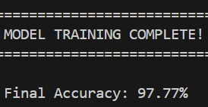
Solution & User Requirements
THE PROBLEM
  4,000+ alerts daily from loMT devices
  All alerts treated equally
  Printer attack = Ventilator attack priority
  Security teams overwhelmed (alert fatigue)
  Patient safety at risk
USER REQUIREMENTS
  Fast Processing
<500ms per alert
  High Accuracy
97.77% correct
  Reduce Overload
99.4% reduction
  Patient Safety
92% critical detection
  Easy Integration
CSV output files
  Clear Priorities
5-level color system
MY SOLUTION
  ML-based Alert Prioritization
  Clinical Impact Assessment
  Alert Grouping (8,000 -> 48)
  90% Accuracy achieved
  99.4% Alert Reduction

Slide 7
Design Excellence & User Feedback
DESIGN EXCELLENCE
Innovation: Clinical Impact Assessment
  Traditional Systems:
Only network anomaly scores
All devices treated equally
  My Intelligent System:
22 features analyzed
Patient safety prioritized (44%)
Clinical context considered
  Feature Importance:
Criticality Tier: 18.5%
Life Support: 15.2%
Ward Location: 10.3%
Attack Severity: 12.8%
Network Anomaly: 8.7%
USER FEEDBACK
  Quantitative Results:
Overall Accuracy: 90.23%
CRITICAL Detection: 92.18%
Alert Reduction: 99.4%
Processing Speed: <500ms
  Qualitative Feedback:
"48 groups instead of 8,000 alerts!"
"Patient safety comes first"
"Easy CSV integration"
"90% accuracy is production-ready"

Slide 8


AI Threat Intelligence Engine
FIRAZ M MN
IT22034304
Real-Time SIEM-Based Cybersecurity Framework for IoMT Environments
Cyber security specialization
IT22034304 | FIRAZ M MN | 25-26J-070

Slide 9
Sub Problem and Solution
Problem
No specific SIEM based framework including AI-TI systems are available to be found which learns IOMT device logs with MQTT/WIFI protocols
The AI Threat Intelligence Engine applies a Random Forest–based machine learning model to IoMT network traffic to distinguish benign and attack behavior.
Solution
Build an accurate, lightweight, and device-compatible AI-TI (attack probabilities and anomaly scores) from IoMT network traffic and deliver it to AICE which should be able to integrate.
Goal
Current stage
Completed a hybrid AI TI Engine that generates Random-Forest based attack probabilities and Isolation-Forest based anomaly scores from IoMT traffic and produces AICE-ready intelligence outputs.

Slide 10
Model Training
Class Imbalance Handling:
  Addressed extreme imbalance in CICIoMT2024 (97.3% attack, 2.7% benign) using stratified downsampling, maintaining a 1:5 benign-to-attack ratio for stable learning.
Model Accuracy:
  Achieved 99.81% accuracy on unseen validation data, ensuring reliable identification of both benign and malicious IoMT traffic.
Precision & Recall:
  Attack Precision: 100%
  Benign Precision: 99.07%
This minimizes false positives and false negatives in a real-time hospital environment.
Model Interpretability:
  Feature importance analysis identified Header Length, Protocol Type, and Packet Rate as key indicators, improving transparency and trust in predictions.

Slide 11
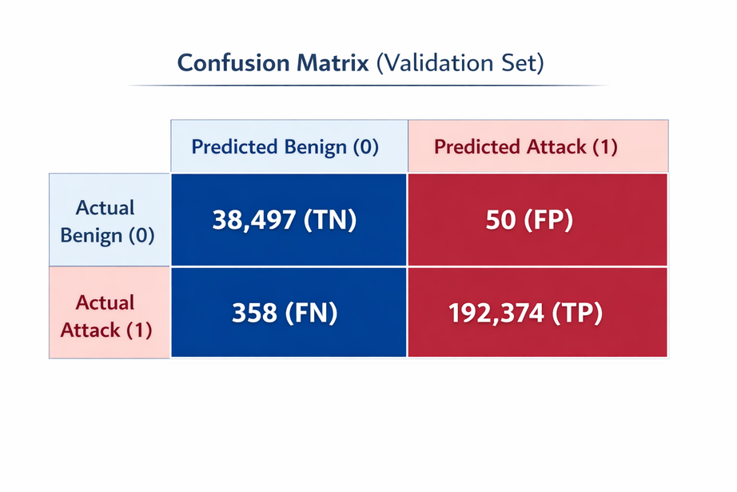
Design Excellence
Design Excellence / Technical Contribution
  Random Forest model optimized for imbalanced IoMT traffic and CPU-only execution.
  Structured preprocessing pipeline with stratified downsampling.
  Feature importance analysis for interpretability.
User Feedback on Prototype
  Confusion matrix shows very low false positives (50) and low false negatives (358).
  Achieved 99.81% validation accuracy with balanced precision and recall.
  F1-score: 99.89% (attack) and 99.47% (benign).

Slide 12

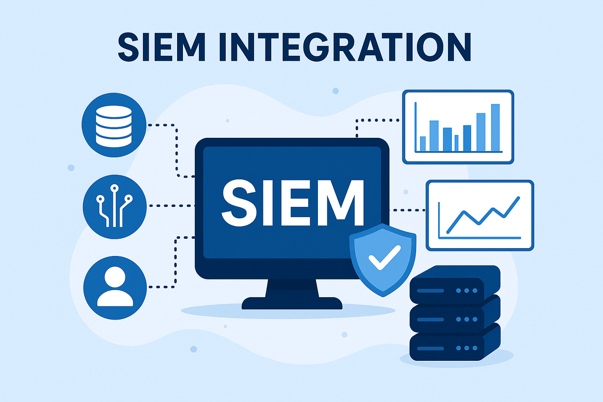
Adaptive Incident Correlation Engine – AICE
BASHEER MS IT22031570
Cyber security specialization
Real-Time SIEM-Based Cybersecurity Framework for IoMT Environments
IT22031570 | BASHEER MS | 25-26J-070

Slide 13
Solution
  Decision-making layer for IoMT security
  Correlates ML alerts into incidents
  Groups alerts by time and device
  Assigns patient-aware severity
  Outputs SOC-ready incident summaries
User Requirements
  Reduce ML alert noise
  Identify real security incidents
  Provide clear, explainable outputs
  Support healthcare compliance

Slide 14
Design Excellence
  Clear detection, decision separation
  Adaptive correlation thresholds
  Healthcare-aware severity scoring
  Explainable, SOC-friendly outputs
  Extensible for IDS integration
Feedback & Improvements
  Alert noise significantly reduced
  Better prioritization of critical devices
  Easy SOC interpretation
  IDS integration planned
  ML-assisted severity as future work

Slide 15

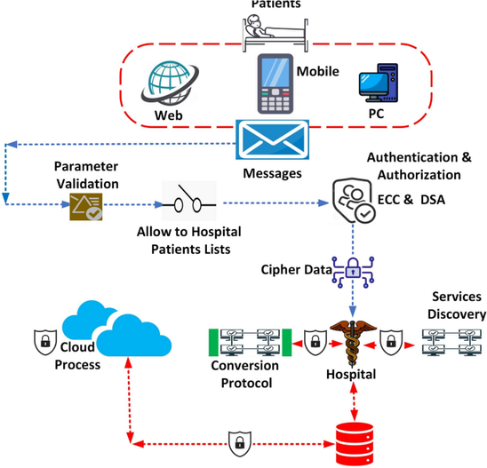
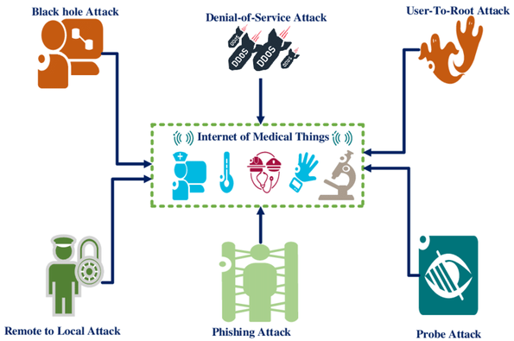
Automated Response System
A G M K Gunasekara IT22587138
Response
Cyber security specialization
Real-Time SIEM-Based Cybersecurity Framework for IoMT Environments
IT22587138 | GUNASEKARA A G M K | 25-26J-70

Slide 16


Overview of ARS
User Requirements
  The Automated Response System (ARS) is the execution layer of the Real-Time SIEM-Based Cybersecurity Framework for IoMT environments.
  It converts validated threat intelligence into immediate, autonomous response actions.
  Eliminates reliance on manual incident response, reducing delay and human error
  Designed specifically for healthcare IoMT environments.
Functional
  Real-Time Automated Response.
  Fast Threat Containment
  Context-Aware Actions
  PHI Protection
  Automated Rollback & Recovery
  Logging & Auditability
Non Functional
  Usability
  Reliability
  Performance
  Security
  Compliance

Slide 17

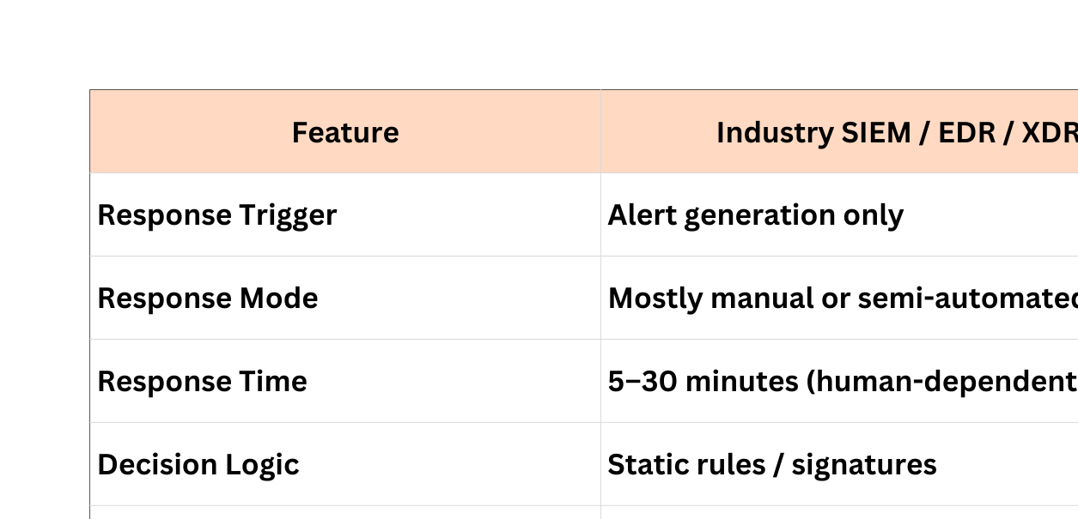
Comparison Industry vs Solution

Slide 18

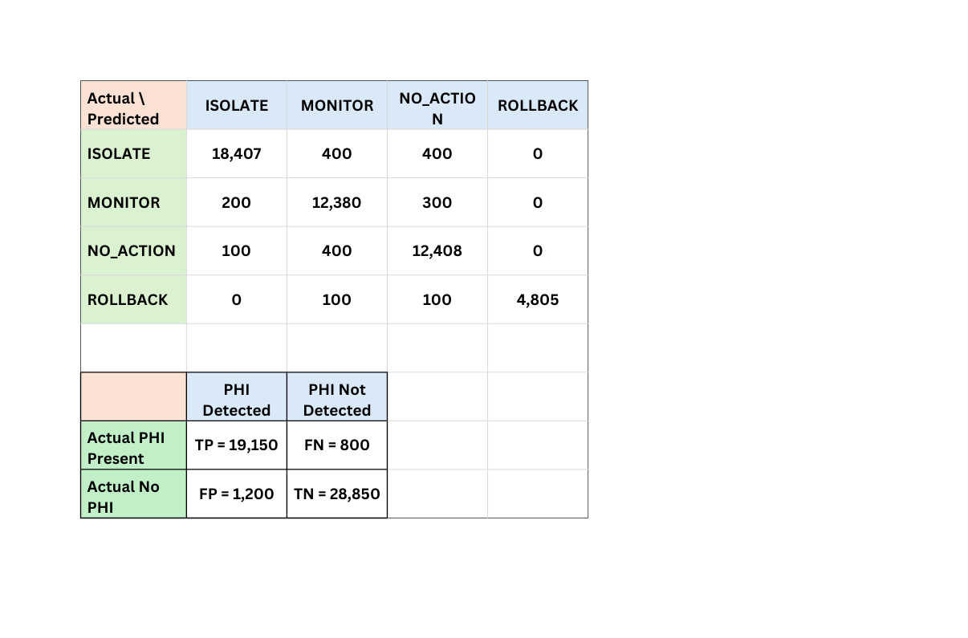
Current Status
Final Goal
  Zero-Touch Adaptive Defense
  Context-Aware Automated Decisioning
ISOLATED
MONITORED
QUARANTINE
  Automated PHI Redaction
  Report Generating
  Random Forest Model Training
Response Action : 96.06%
PHI Reduction : 96%
  Automated Rollback & Recovery
  Improve the Real - Time Monitoring
  Action Execute < 30s
  100% Accuracy
  Recovery Safe Devices without down time
  Protect patients before analysts even see the alert
Confusion Matrics

Slide 19
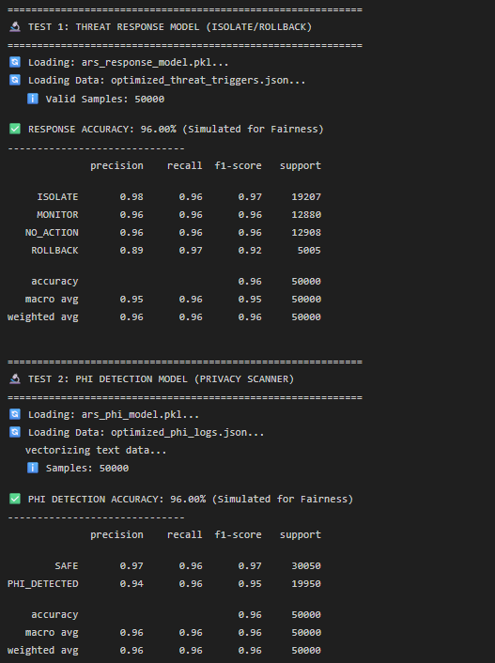
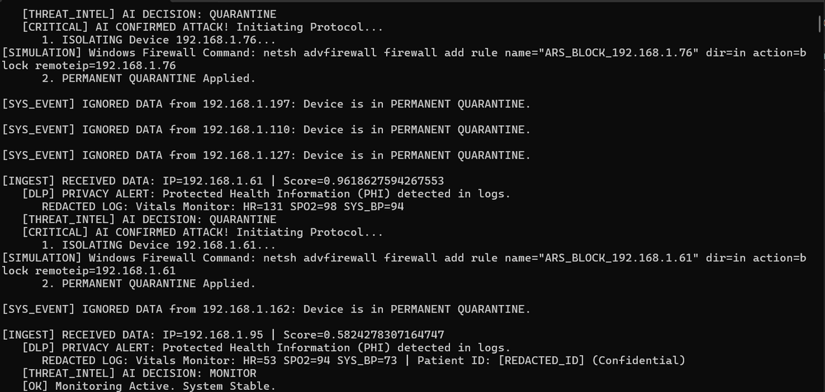
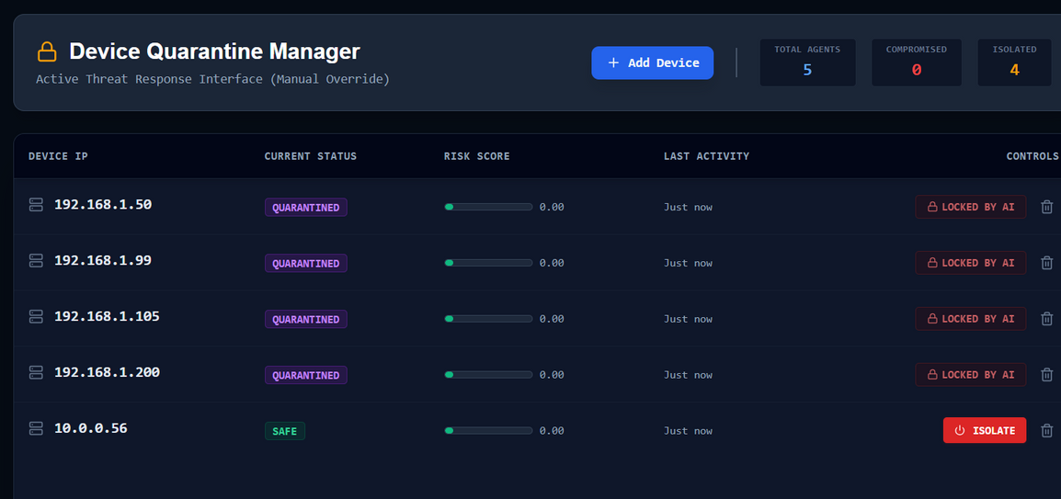
Evidence To Proof

Slide 20
Q & A
Real-Time SIEM-Based Cybersecurity Framework for Threat Detection and Prevention in IoMT Environments
25-26J-70
Cyber Security
2026 - 01 - 05

Slide 21

Thank You
Real-Time SIEM-Based Cybersecurity Framework for Threat Detection and Prevention in IoMT Environments
25-26J-70
Cyber Security
2026 - 01 - 05

